Slide 1
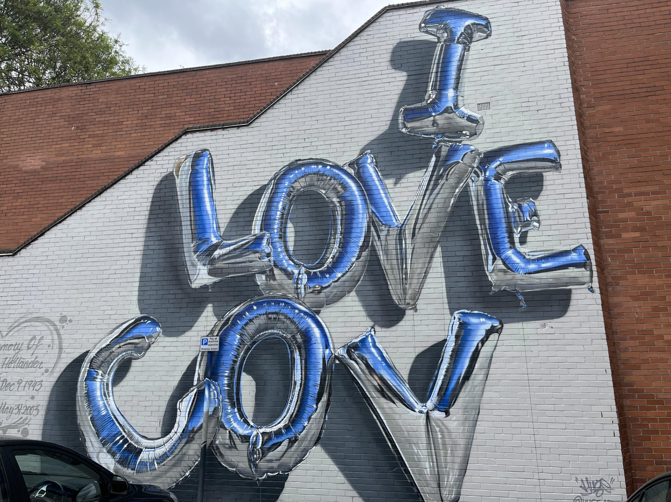
Life is Local:
living out reconciliation in the here and now
The Revd Mary Gregory,
Canon for Arts and Reconciliation
at Coventry Cathedral

Slide 2
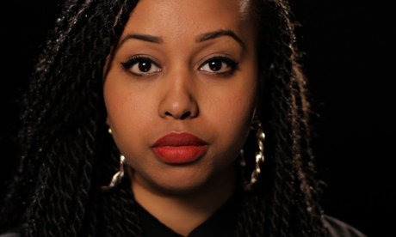

Slide 4
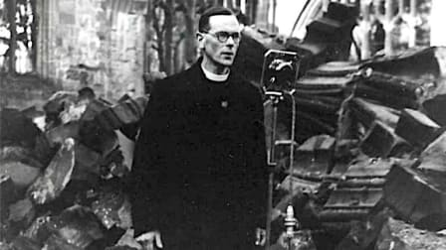

Slide 5
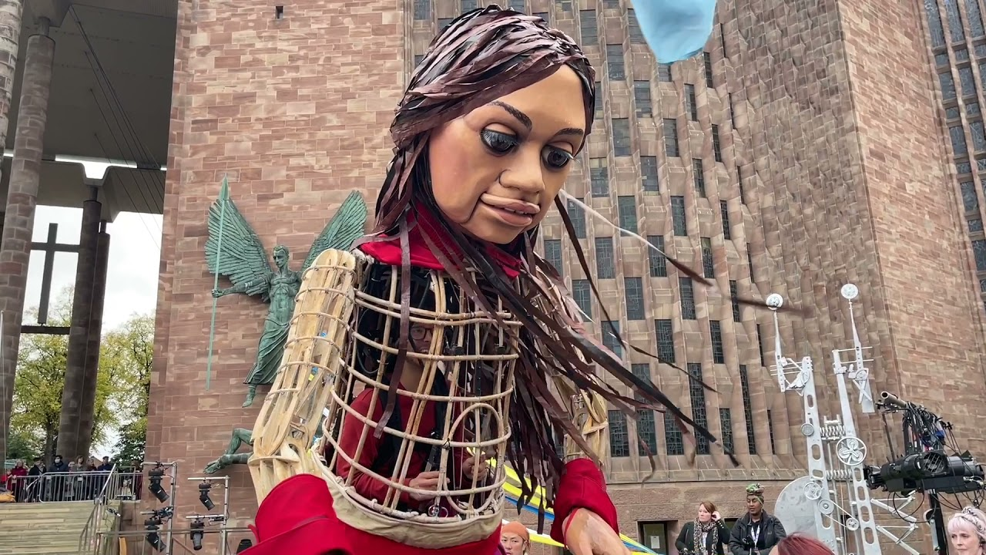

Slide 6
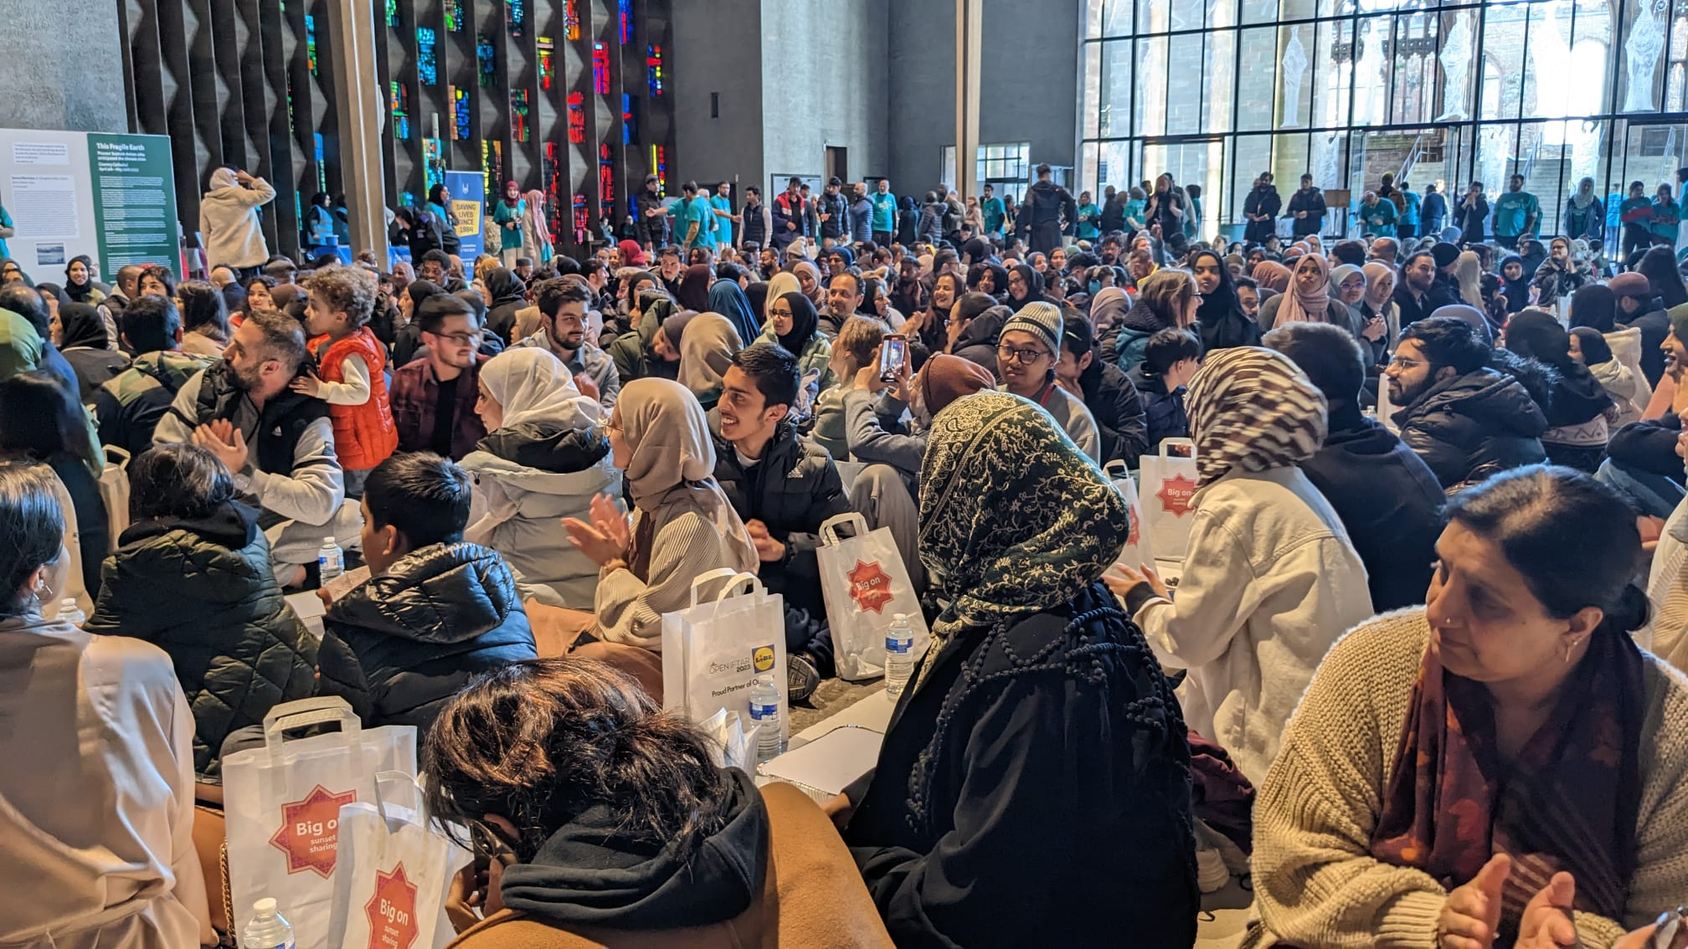

Slide 8
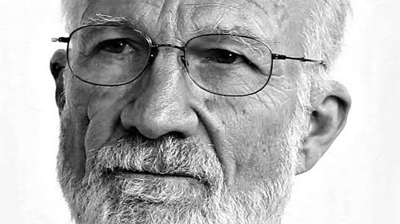

Slide 10
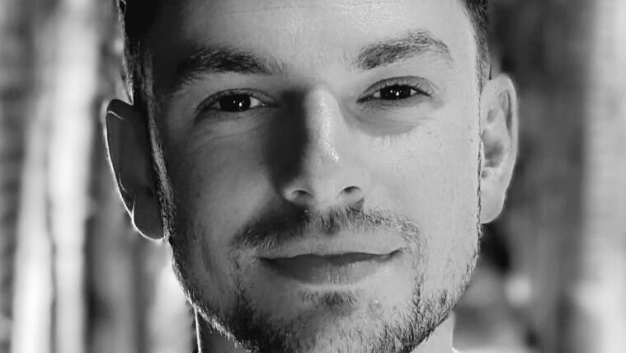

Slide 11
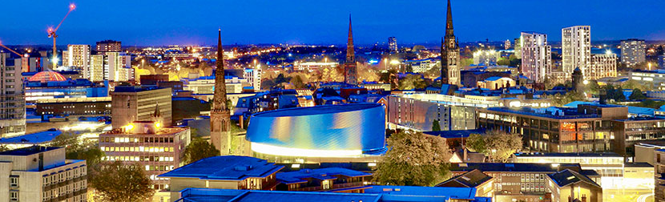
Do not be afraid—
to complete the repair of the world
is not why you were made.
You were created to play
only your part;
whatever is within your hands;
whatever is the now of your heart.

