Slide 1
The life everlasting
Rt Revd Smitha Prasadam

Slide 2
Life begins at…
1,700th anniversary of the Nicene Creed
Conflicts in the Church
How we can create communities of faith, sharing respect

Slide 3
“I have come that they may have life, Life in all its fulness” John 10:10

Slide 4
we believe in one god… we believe in one lord, Jesus Christ… we believe in the holy spirit…

Slide 5
ONE
HOLY
CHURCH
APOSTOLIC
CATHOLIC

Slide 6
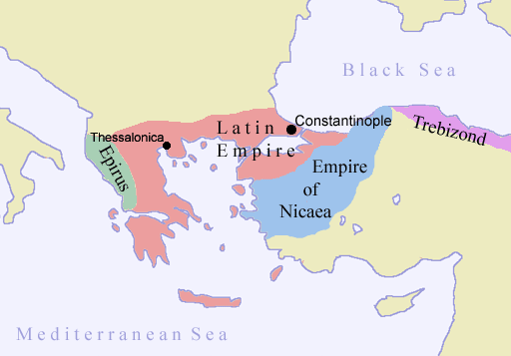
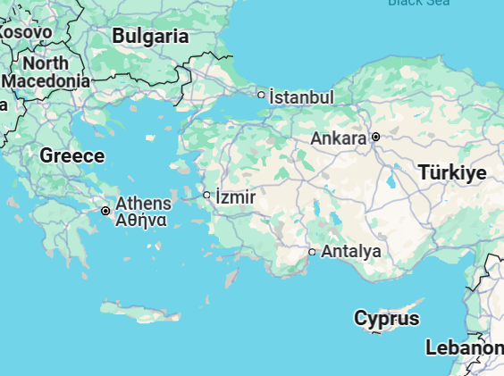
Where is nicaea?

Slide 7
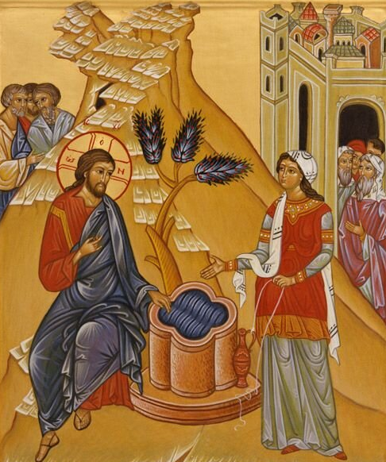
Photini John 4

Slide 8
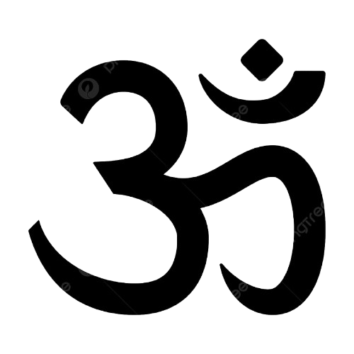
Reconciling mission
HOLY
HOLI
HOLA

Slide 9
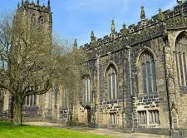
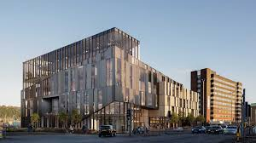
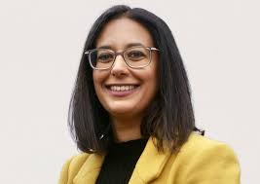
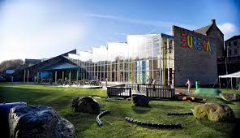
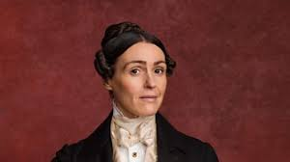
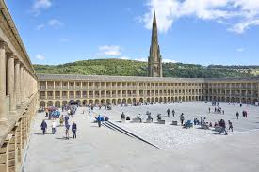
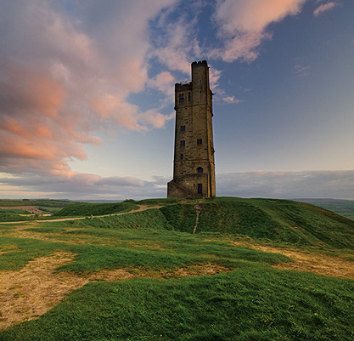
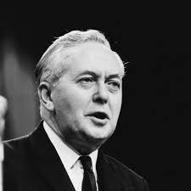
The hud

Slide 10
Disruptive grace
Costly / Comfortable
Individual / Community
Radical / Robust

Slide 12
In conversation with
How we’re doing it…
Dr Edward Kessler MBE
High Sherrif Adeeba Malik
Rebecca Newby
Alison Lowe
Kim Leadbeater MP
Baroness Sayeeda Warsi
Acts 17.22-28

Slide 13
The unfolding story…
What creed would you write for your diocese?
What aspect(s) would be contested?
How would you emphasise the life everlasting?

Slide 14
The life everlasting
Rt Revd Smitha Prasadam

