Slide 1
Listening to Laity:
Synodality, Spirituality, and the Mission of God
Joshua Cockayne
Cranmer Hall Durham

Slide 2
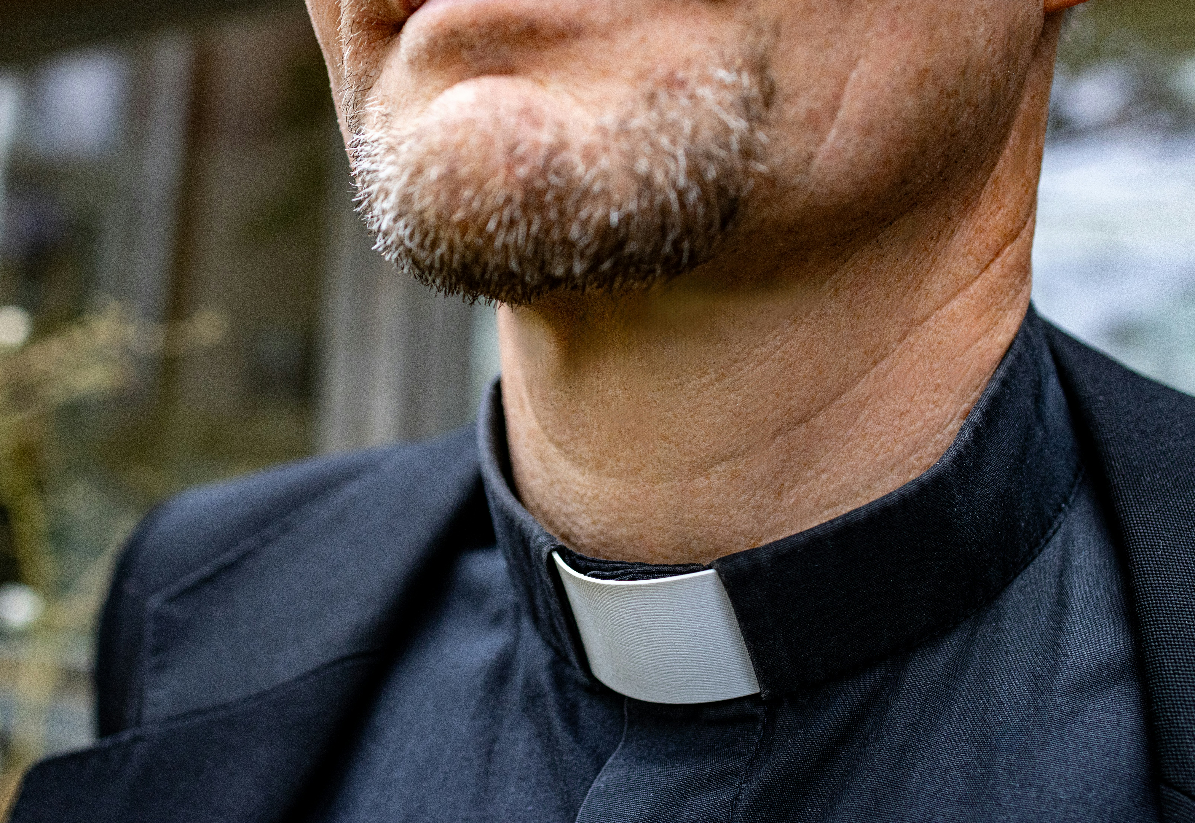
Missio dei or
Missio Dave?

Slide 3
Today
Synodality and the mission of God
Listening to laity
Listening to community
A foundation of adoration

Slide 4
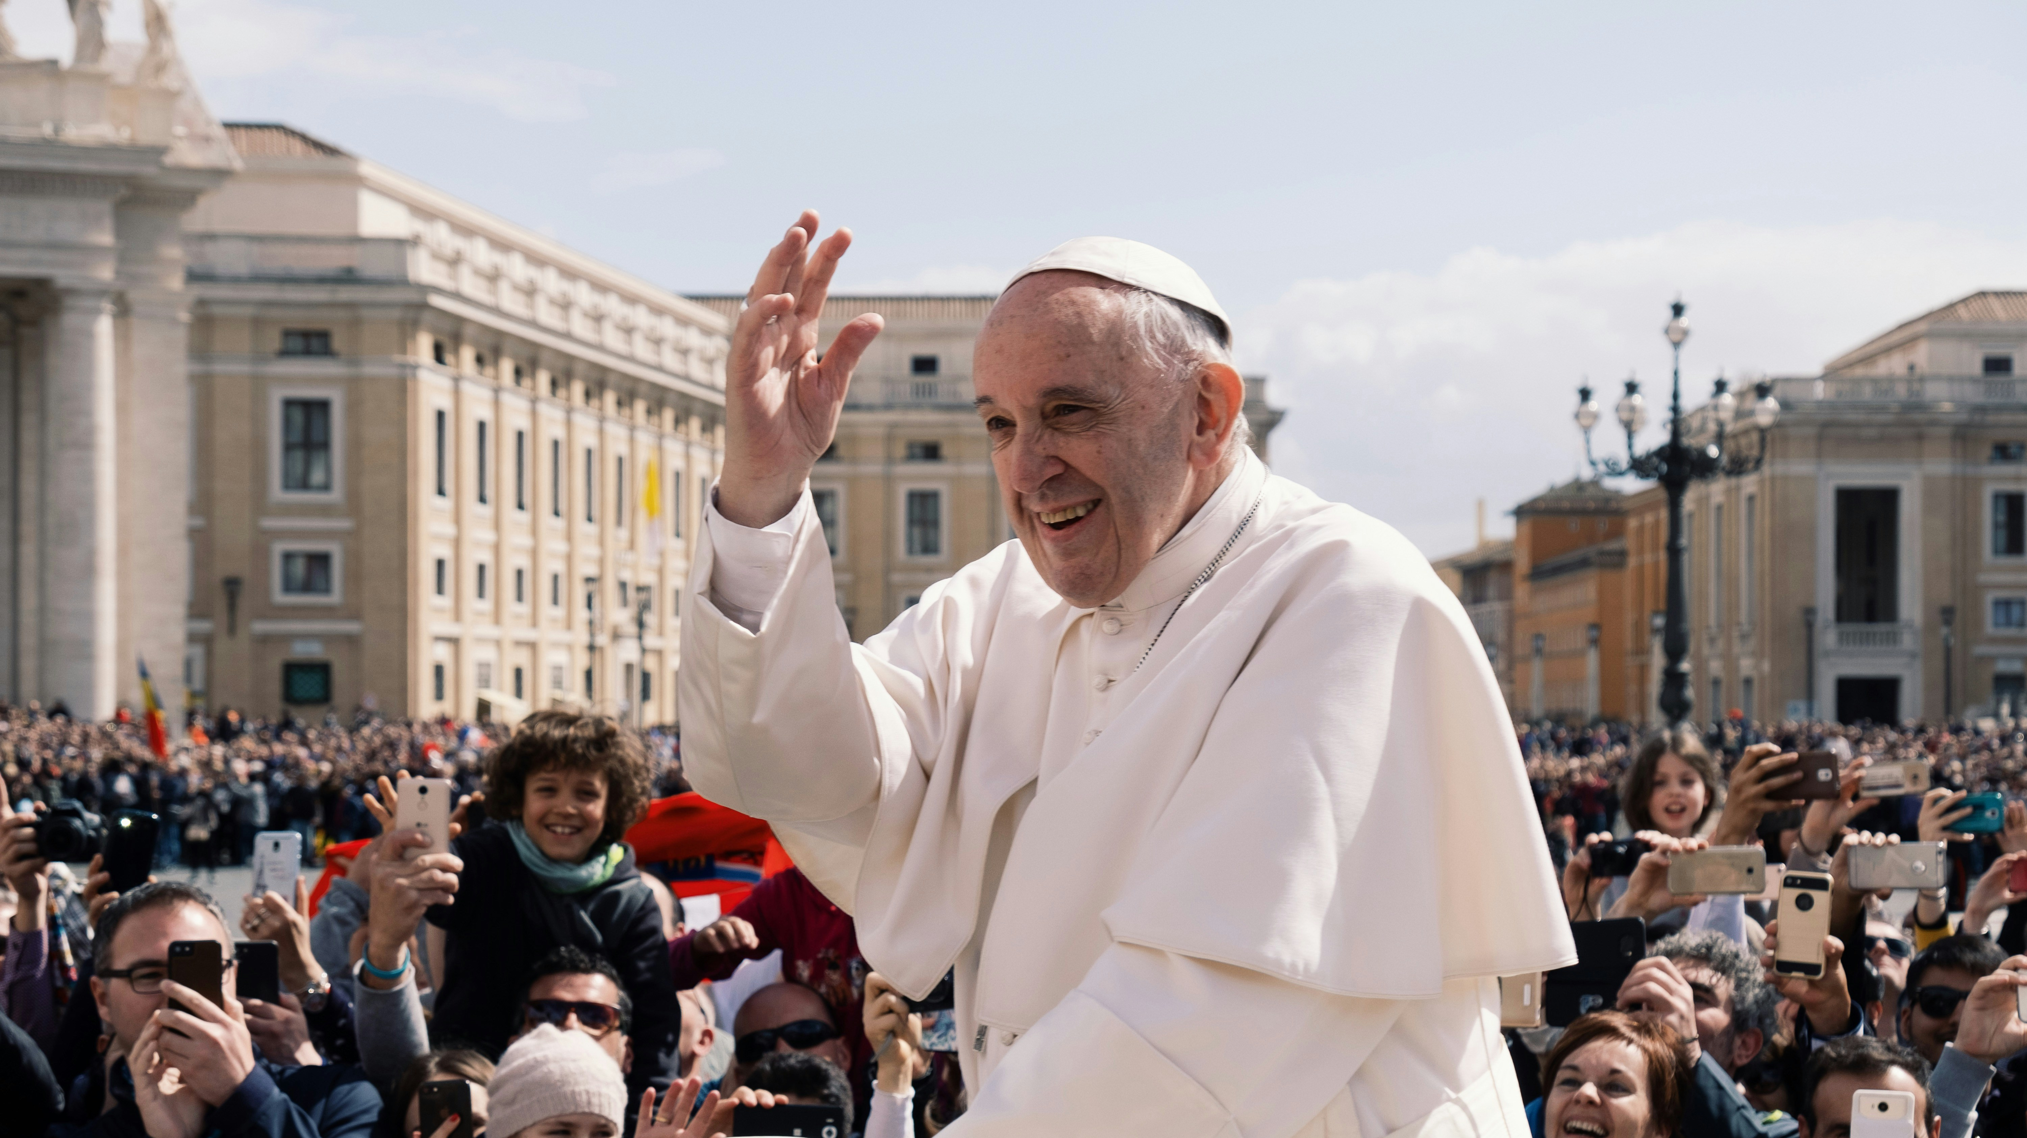
Synodality and the mission of god

Slide 5
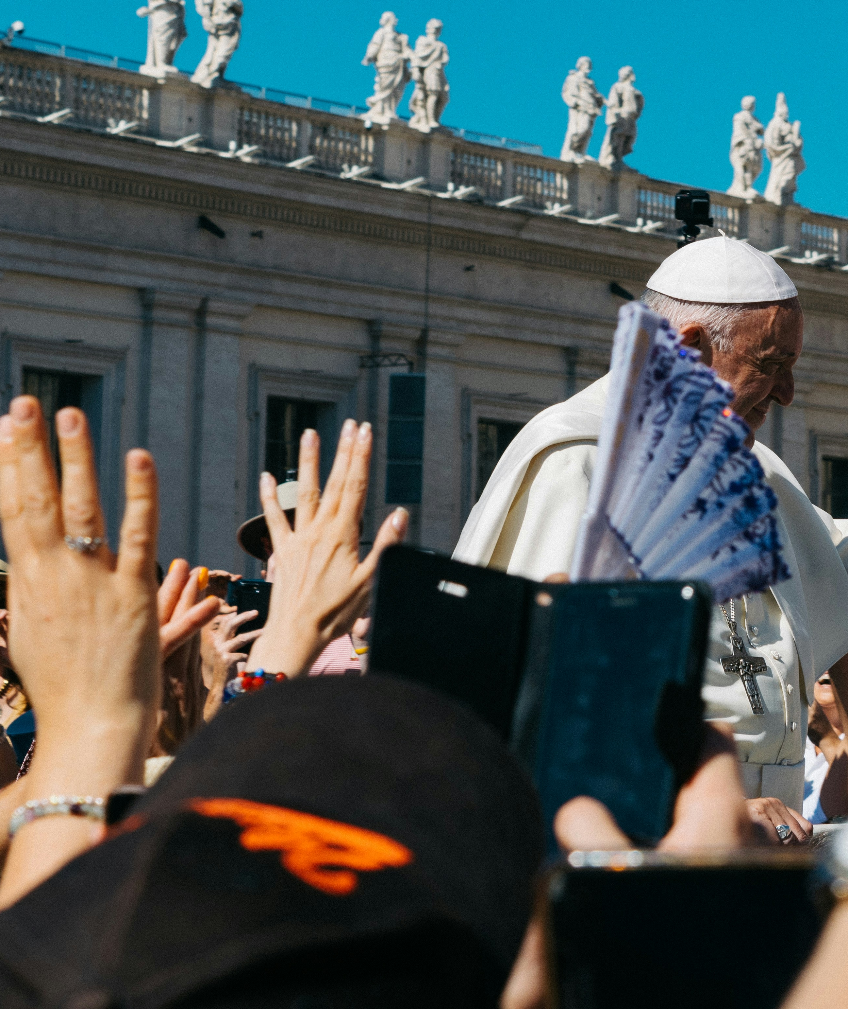
Synodality and the mission of god
“The word of God journeys with us. Everyone has a part to play; no one is a mere extra.”
Walking Together: The Way of Synodality (New York: Orbis Books), 152

Slide 6
Synodality and the mission of god
“In front to show the way, in the middle to sense how people feel, behind to help the stragglers, letting people sniff out where the best pastures are found”.
Synodality, 158.

Slide 7
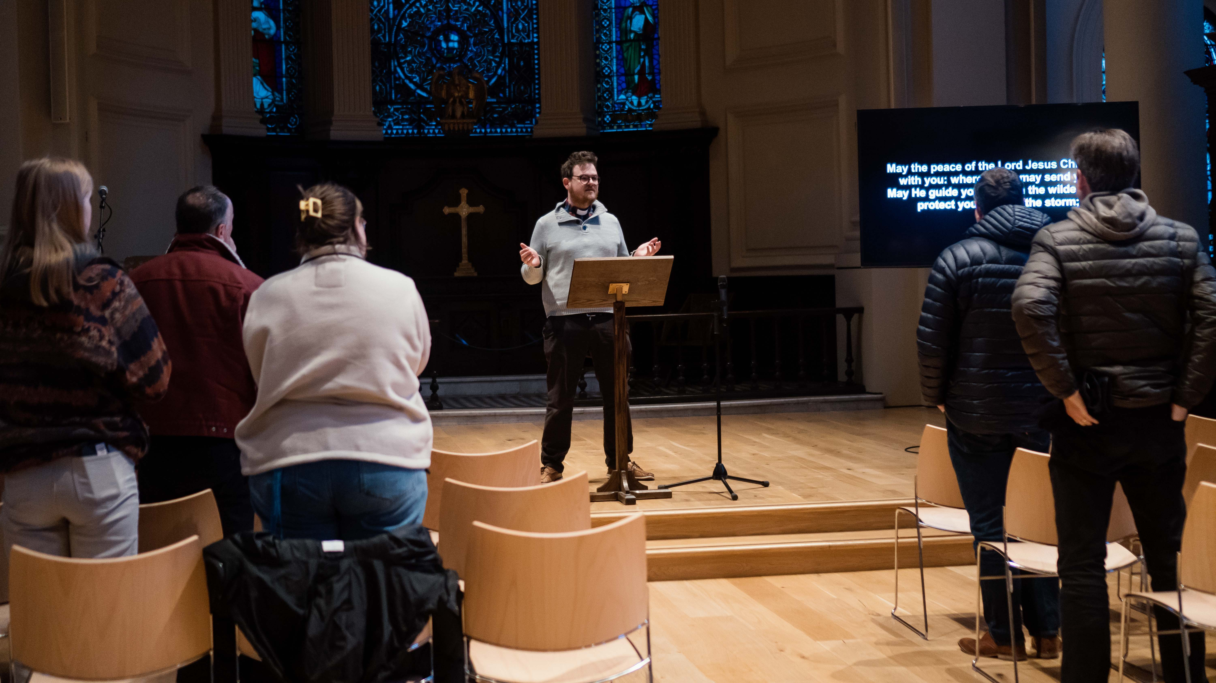
Listening to laity

Slide 8

Listening to Laity
“the Body of Christ, the people of God and the dwelling-place of the Holy Spirit…In baptism the whole Church is summoned to witness to God’s love and to work for the coming of his kingdom.”
Common Worship Ordination Service.

Slide 9

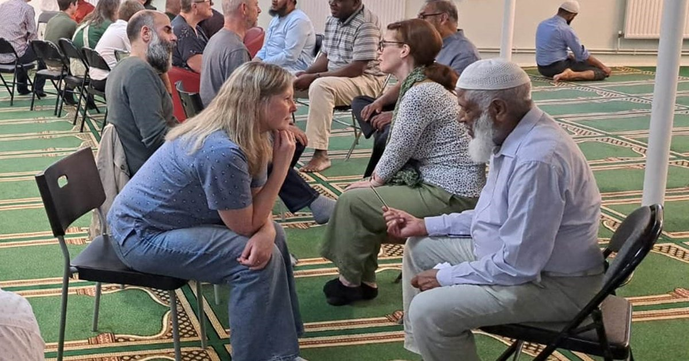
Listening to Laity

Slide 10
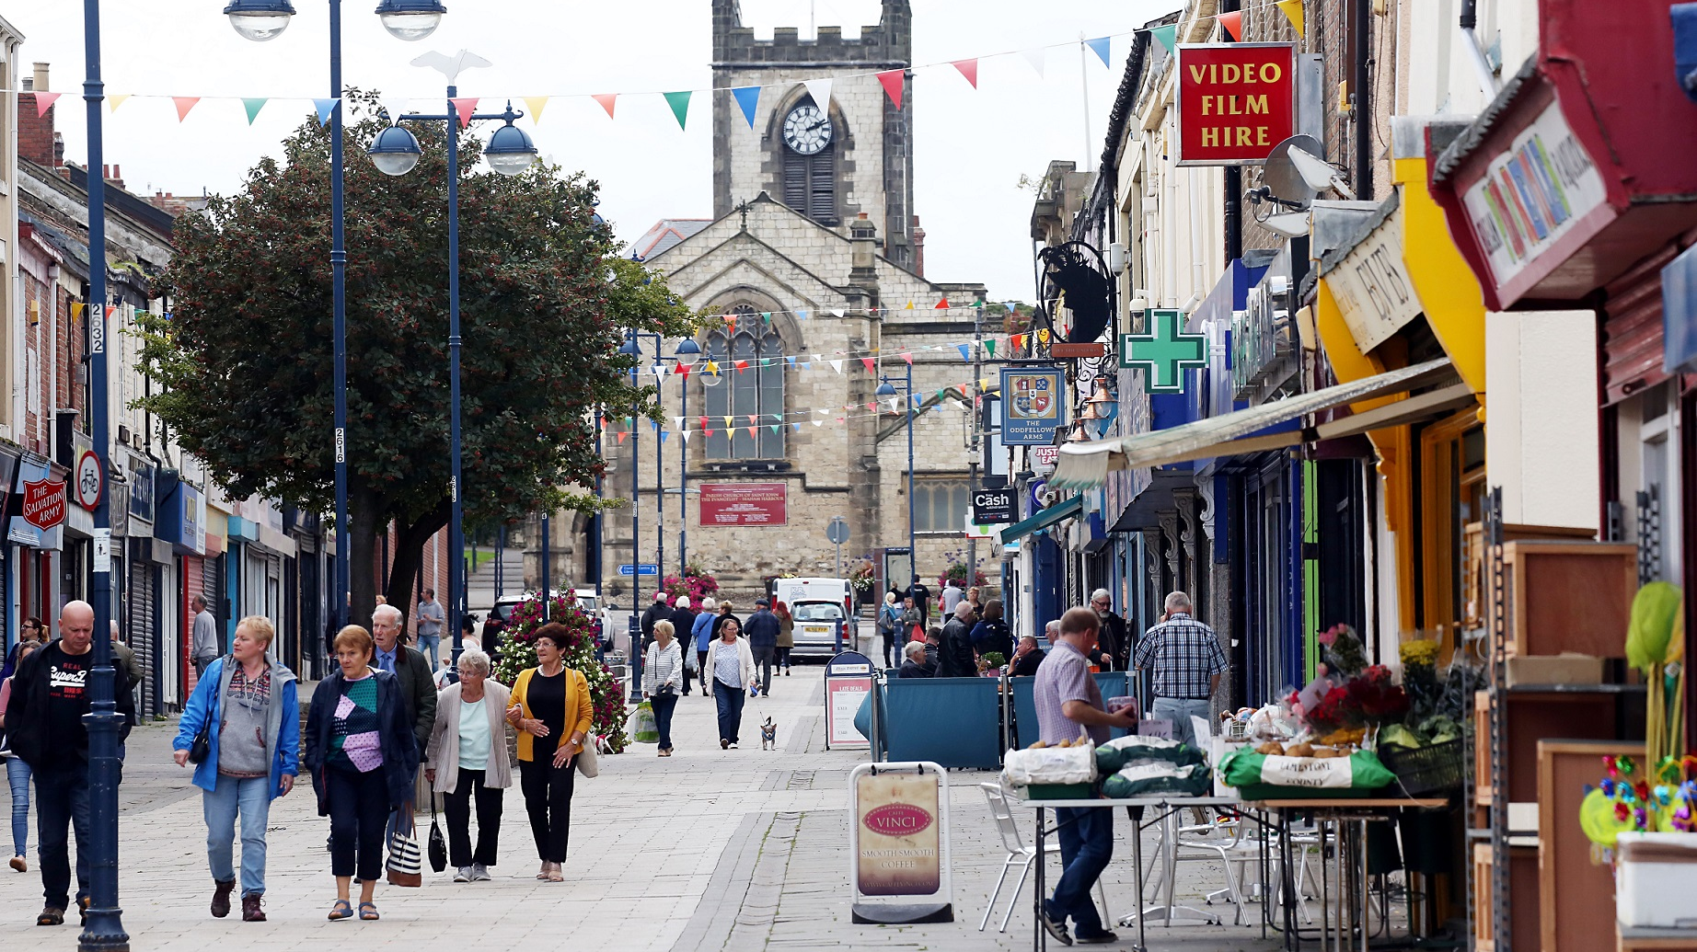
Listening to the Community

Slide 11

Listening to the Community
By slowing down and paying close attention to the realities of people and place, Synodal organising provides a set of tools with which to ‘discern’ both individually and collectively.
Not only with words, 6.

Slide 12
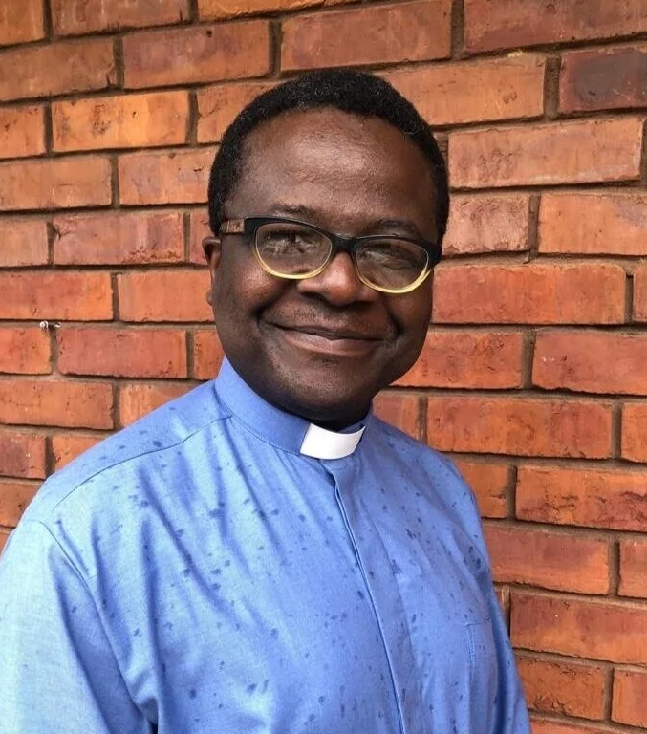
Listening to the Community
…we still didn’t have anything resembling church or a church plant. Yet, I had established visibility and recognition as a trusted voice and stakeholder in the community. …I receive warm appreciation for having helped to deliver the pedestrianized path and we continue conversations about issues affecting us – as neighbours!
Participation and Church Planting, pp.216-17

Slide 13

A foundation of adoration

Slide 14
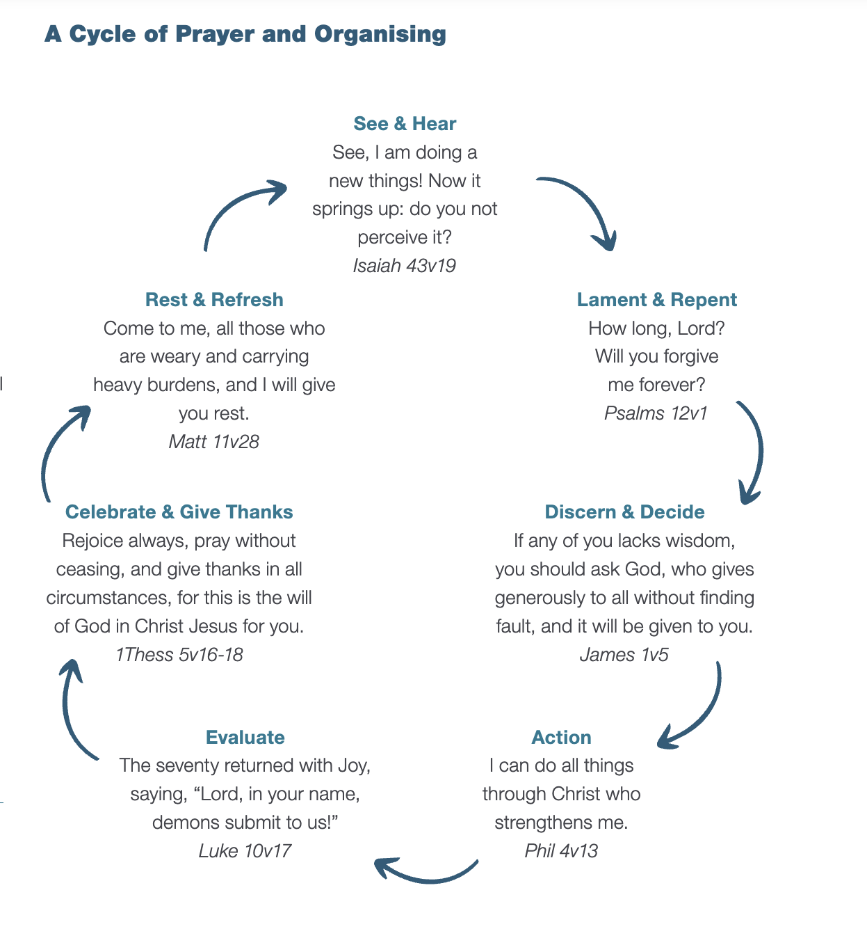
A foundation of adoration
See & Hear
Rest and Refresh
Lament & Repent
Celebrate & Give Thanks
Discern & Decide
Evaluate
Action

Slide 15
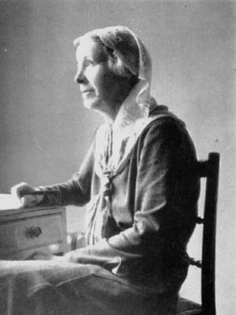
A foundation of adoration
Much is now being said about evangelism; but before we get effective evangelism, we have to get effective evangelists. Evangelism is useless, unless it is the work of one devoted to God, willing and glad to suffer all things for God, penetrated by the attractiveness of God. New machinery, adaptations and adjustments, are not the first need of the Church of England; but more devoted, adoring, sacrificial souls. These are supernatural qualities, given by God in our hours of direct attention to Him; and these are the only lasting source of that charity, that invincible loving kindness which will help us to show the beauty of Christ to others and so win them for God
Underhill, Evelyn, Collected Papers of Evelyn Underhill, Edited by Lucy Menzies, (London, Longmans, Green and Co, 1946), 144-45.

Slide 16
A foundation of adoration
spreading through the parish like leaven, deeply concerned with its life and problems, lifting up to God its anxieties, sorrows, and sins….In this way they are drawn into a living spiritual fellowship and released from loneliness; and are given an entirely new sense of sharing in the life and work of their church.
Papers, 171.

Slide 17
Listening and the missio dei

Slide 18
Come, Holy Spirit! You inspire new tongues and place words of life on our lips: keep us from becoming a “museum Church”, beautiful but mute, with much past and little future. Come among us, so that in this synodal experience we will not lose our enthusiasm, dilute the power of prophecy, or descend into useless and unproductive discussions. Come, Spirit of love, open our hearts to hear your voice! Come, Holy Spirit of holiness, renew the holy and faithful! People of God! Come, Creator Spirit, renew the face of the earth! Amen’

Slide 19
Further questions
Where do you see the needs and opportunities to listen to your congregation?
What might it look like to listen from the front, the middle, and the back?
Where do you see the needs and opportunities to listen to your wider community?
How might community organising principles help you to engage more deeply with communities?
Where are the opportunities to grow a devoted community of those who are deepening in the practice of adoration? How can you prioritise this in your ministry?

